Slide 1
The Effect of Fictional Reappraisal on Subjective Ratings Toward Erotic Images

Slide 2
FictionEro1
Notes:
https://github.com/RealityBending/FictionEro

Slide 3

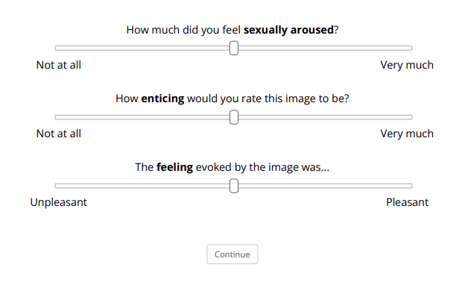

Refresher Paradigm FictionEro1
Assessment
PHASE 1
END PHASE 1
AI-Generated
Photograph
Questionnaires
1-2 s
3 s
1-2 s
3 s
Questionnaires
COPS - Consumption of Pornography Scale (Hatchet al., 2023)
Porn Frequency: How often have you viewed pornography in the past 30 days?
I viewed pornography weekly
I viewed pornography daily
…
Porn Duration: When I view pornography, I view it for...
Less than 5 minutes
36-45 minutes
…
Sexual Activity: When was the last time you engaged in any kind of sexual activity (intercourse or masturbation)?
Less than 24h ago
Within the last year
….
Variables
Arousal – How much did you feel sexually aroused?
0 = Not at all; 1 = Very much
Enticement – How enticing would you rate this image to be?
0 = Not at all; 1 = Very much
Valence – The feeling evoked by this image was…
0 = Unpleasant; 1 = Pleasant
Notes:
Arousing-positive → valence > 5 (norms)

Slide 4
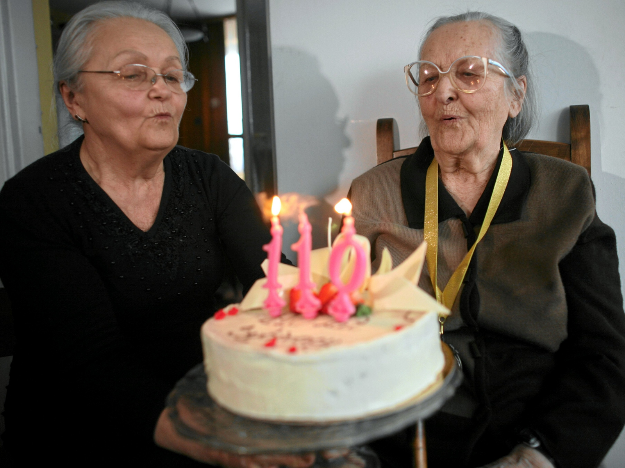

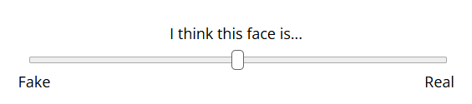
Refresher Paradigm FictionEro1
END OF PHASE 1
PHASE 2
Questionnaires (cont.)
3 s
3 s
Variables
Realness - I think this face is… 0 = Fake , 1 = Real
Questionnaires
BAIT - Beliefs about Artificial Images Technology (Revised in Makowski et al. 2025)
- Includes 3 negative and 3 positive items from the General Attitudes towards Artificial Intelligence Scale (GAAIS; Schepman et al., 2020, 2022)
- e.g., Current AI algorithms can generate very realistic images
0 = Disagree; 6 = Agree
AI – Knowledge - How knowledgeable do you consider yourself about Artificial Intelligence (AI) technology? 0 = Not at all; 6 = Expert
Notes:
Arousing-positive → valence > 5 (norms)

Slide 5
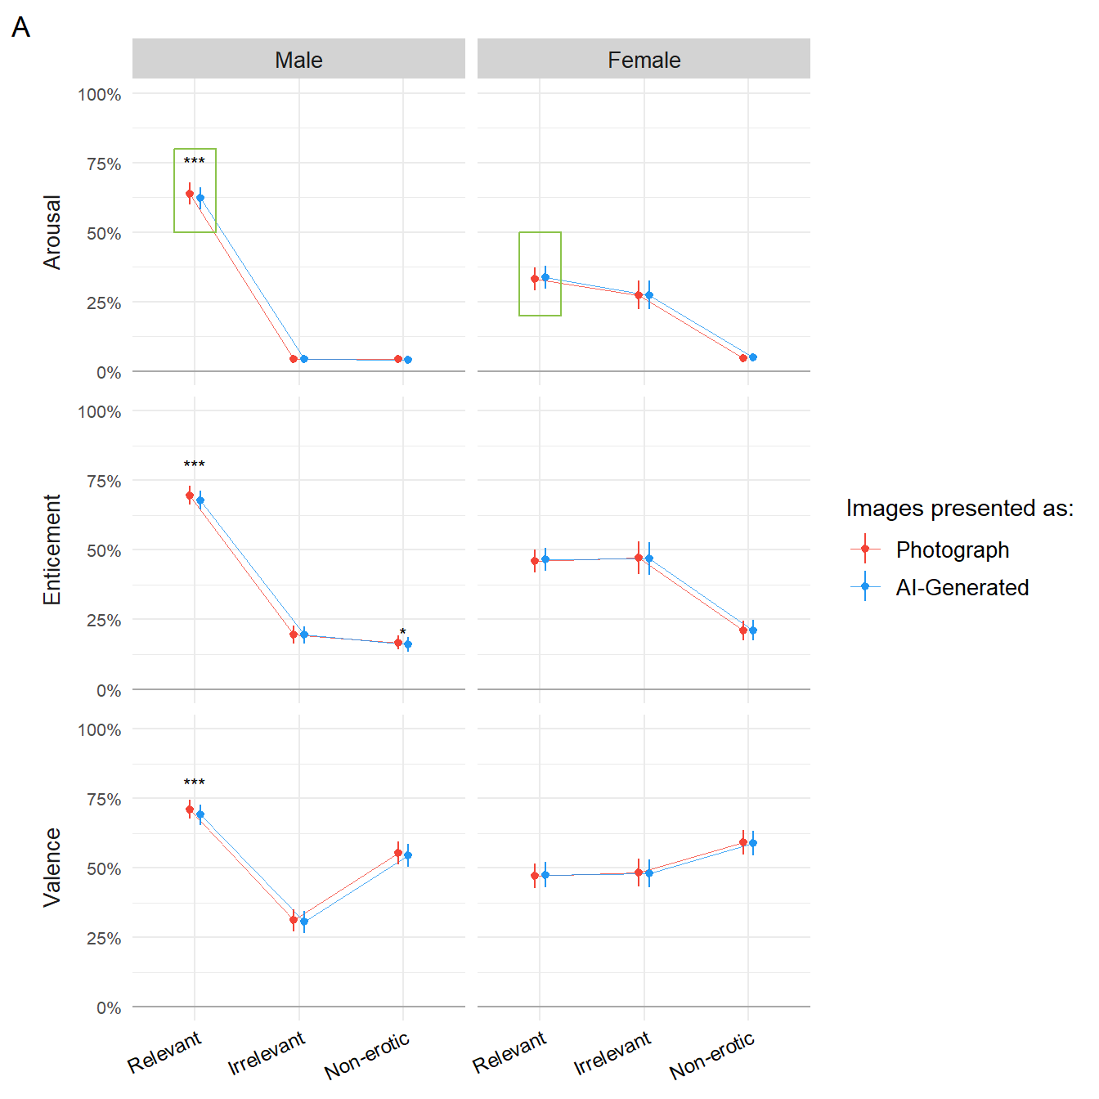
Refresher FictionEro1
Every participant saw 60 images – Erotic (20 men and 20 women) and Non-Erotic (10 neutral and 10 positive arousing)
Relevance was computed after according to Gender and Sexual Orientation
The final sample included 705 participants (Mean age = 30.2, SD = 11.8), 35.7% females, 64.3% males.
Main findings on emotional ratings
Relevant images were rated higher in Arousal, Enticement and Valence for males
For females, only the ratings of arousal were higher for relevant images
Females rated relevant images significantly lower than men in all subjective ratings
The effect of condition was significantly only for men, with relevant images presented as AI-generated being rated lower in all subjective ratings
Notes:
Arousing-positive → valence > 5 (norms)

Slide 6
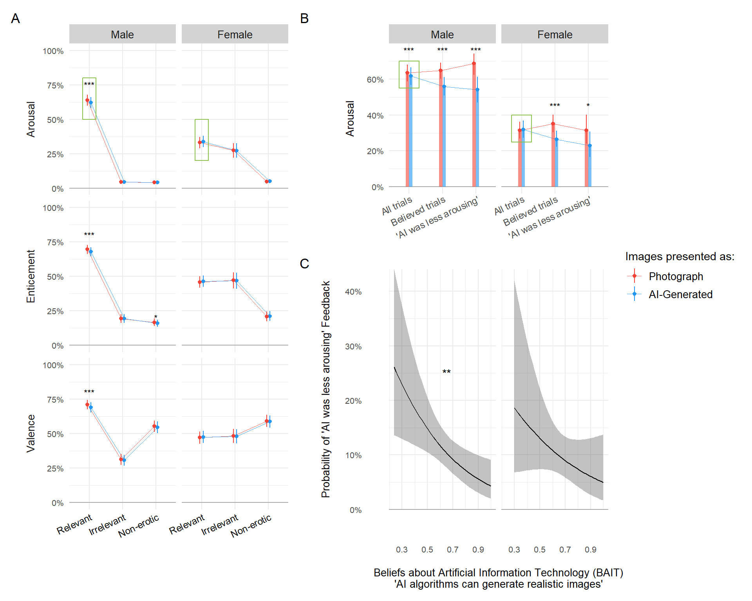
Refresher FictionEro1
Moderators
Feedback that AI-Generated images were more arousing was a significant moderator for females’ ratings of arousal and enticement
Feedback That AI-Generated images were less arousing was a significant moderator for males’ ratings of arousal
Beliefs about AI capability was a significant predictor of the probability that AI images were less arousing for males only
Porn usage was a significant moderator of arousal ratings for females for images labelled AI-generated
Notes:
Arousal:
Females who reported that AI-Generated images were more arousing rated these images higher in arousal compared to images labelled as photographs. (b =.15, p < .05)
Males who reported that AI-Generated images as less arousing rated these images lower in arousal compared to images labelled as photographs. (b = -.14 , p < .05)
Females who reported that AI-Generated images were more arousing rated these images higher in enticement compared to images labelled as photographs (b =.15, p < .05).
Males who reported that they could not discriminate between AI-Generated and photograph images, rated AI-Generated images higher in valence compared to images labelled as photographs (b = .11, p <.01)
The effect of AI-Generated condition on arousal ratings varies with different levels of sexual activity for females (b = -.06, p < .05)
Females with higher levels of porn usage rated AI-generated images lower in arousal compared to photographs (b = -.08, p < .05)

Slide 7
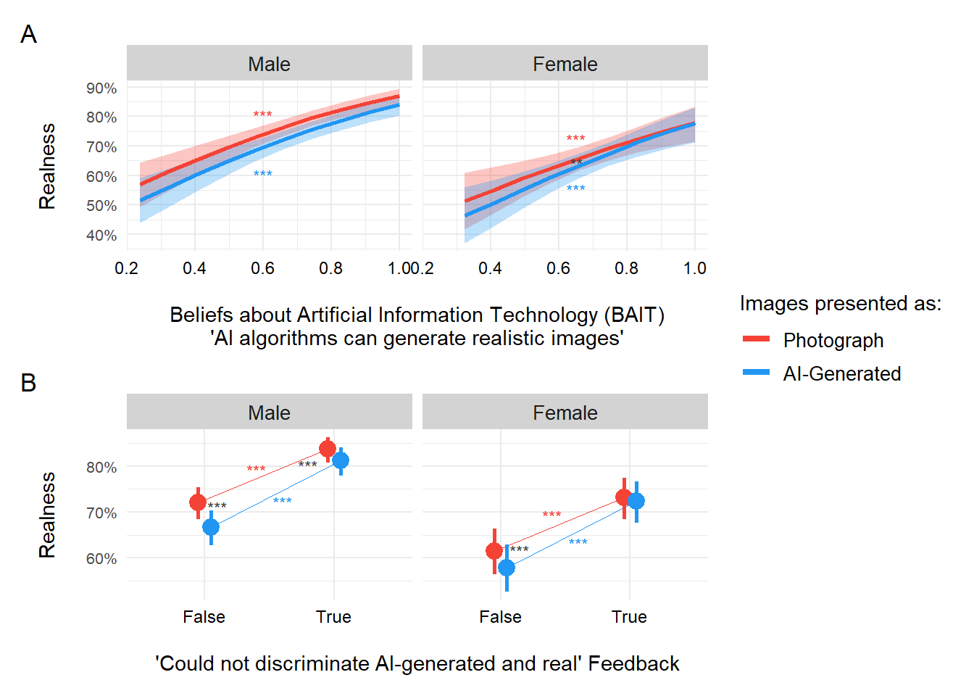
Refresher FictionEro1
Main findings on Realness ratings
In both genders, AI-generated images are perceived as less realistic compared to photographs.
Interestingly, both genders rated non-erotic images as more realistic than relevant and irrelevant images.
As beliefs in AI’s ability to generate realistic images increases, both genders showed higher realness scores.
Females and males who reported an inability to discriminate AI-generated images perceived relevant AI-generated images as more real.
Notes:
Arousal:
Females who reported that AI-Generated images were more arousing rated these images higher in arousal compared to images labelled as photographs. (b =.15, p < .05)
Males who reported that AI-Generated images as less arousing rated these images lower in arousal compared to images labelled as photographs. (b = -.14 , p < .05)
Females who reported that AI-Generated images were more arousing rated these images higher in enticement compared to images labelled as photographs (b =.15, p < .05).
Males who reported that they could not discriminate between AI-Generated and photograph images, rated AI-Generated images higher in valence compared to images labelled as photographs (b = .11, p <.01)
The effect of AI-Generated condition on arousal ratings varies with different levels of sexual activity for females (b = -.06, p < .05)
Females with higher levels of porn usage rated AI-generated images lower in arousal compared to photographs (b = -.08, p < .05)

Slide 8
Limitations and Future Improvements FictionEro1
1) Heterogenous Population
However, general populations and students who are not paid for participation seemed to drive subjective ratings (specially among males)
2) Use of mobiles
Mobile influences ratings of arousal → Need to avoid allowing participants to complete this kinds of experiment with mobiles
3) Choice of Stimuli
Lower arousal ratings potentially due to participants being presented with images that were not relevant to their sexual orientation
4) Instructions
“Weaker” cover story → Participants were told there would be AI-generated images mixed with Real images
In phase 2 participants were asked to rate images based on whether they believed them to be real or AI-generated → No truth was revealed to them
Notes:
Arousal:
Females who reported that AI-Generated images were more arousing rated these images higher in arousal compared to images labelled as photographs. (b =.15, p < .05)
Males who reported that AI-Generated images as less arousing rated these images lower in arousal compared to images labelled as photographs. (b = -.14 , p < .05)
Females who reported that AI-Generated images were more arousing rated these images higher in enticement compared to images labelled as photographs (b =.15, p < .05).
Males who reported that they could not discriminate between AI-Generated and photograph images, rated AI-Generated images higher in valence compared to images labelled as photographs (b = .11, p <.01)
The effect of AI-Generated condition on arousal ratings varies with different levels of sexual activity for females (b = -.06, p < .05)
Females with higher levels of porn usage rated AI-generated images lower in arousal compared to photographs (b = -.08, p < .05)

Slide 9
FictionEro2
Notes:
https://github.com/RealityBending/FictionEro

Slide 10
Data Collection and Preprocessing FictionEro2
Recruitment Phase
All participants were recruited through Prolific
Participants were paid £4.24 per submission
About 15% of data was lost – i.e., data was not transferred from prolific to OSF despite participants completing the study
Changes in implementation
Relevance was computed before → Only relevant stimuli presented
Added a GAN-generated GIF of faces → Potentially increase believability in the cover story study
Half-truth revealed → “Some images were intentionally mislabelled” (second phase)
Ratings of how confidence participants were on the nature of the stimuli VS ratings of how realistic the images were
Changes to Stimuli
Only erotic images
Each participant saw 50 images (25 from the two relevant categories)
Notes:
There were only 19 bisexuals, and 8 homosexuals compared to 170 heterosexuals

Slide 11
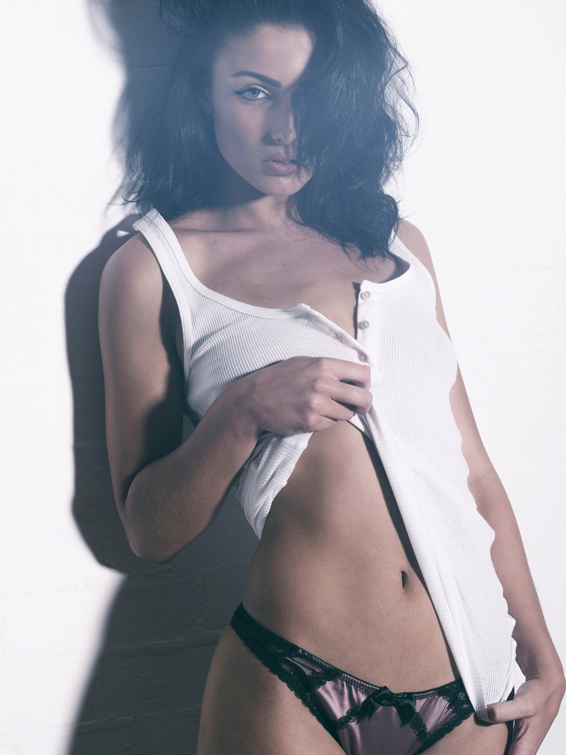
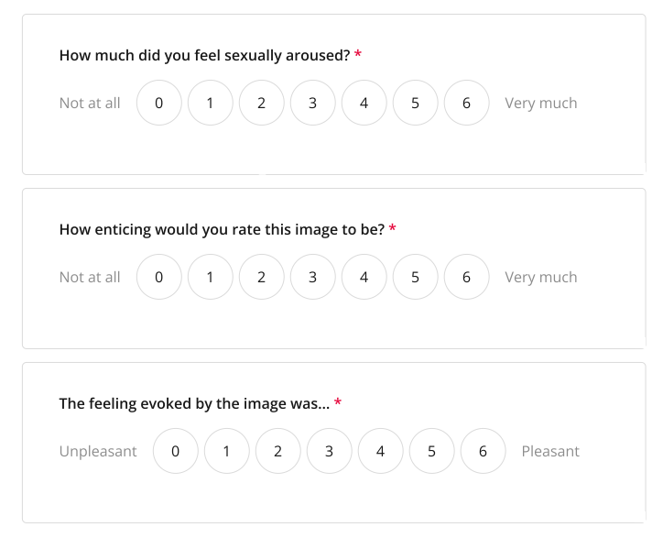
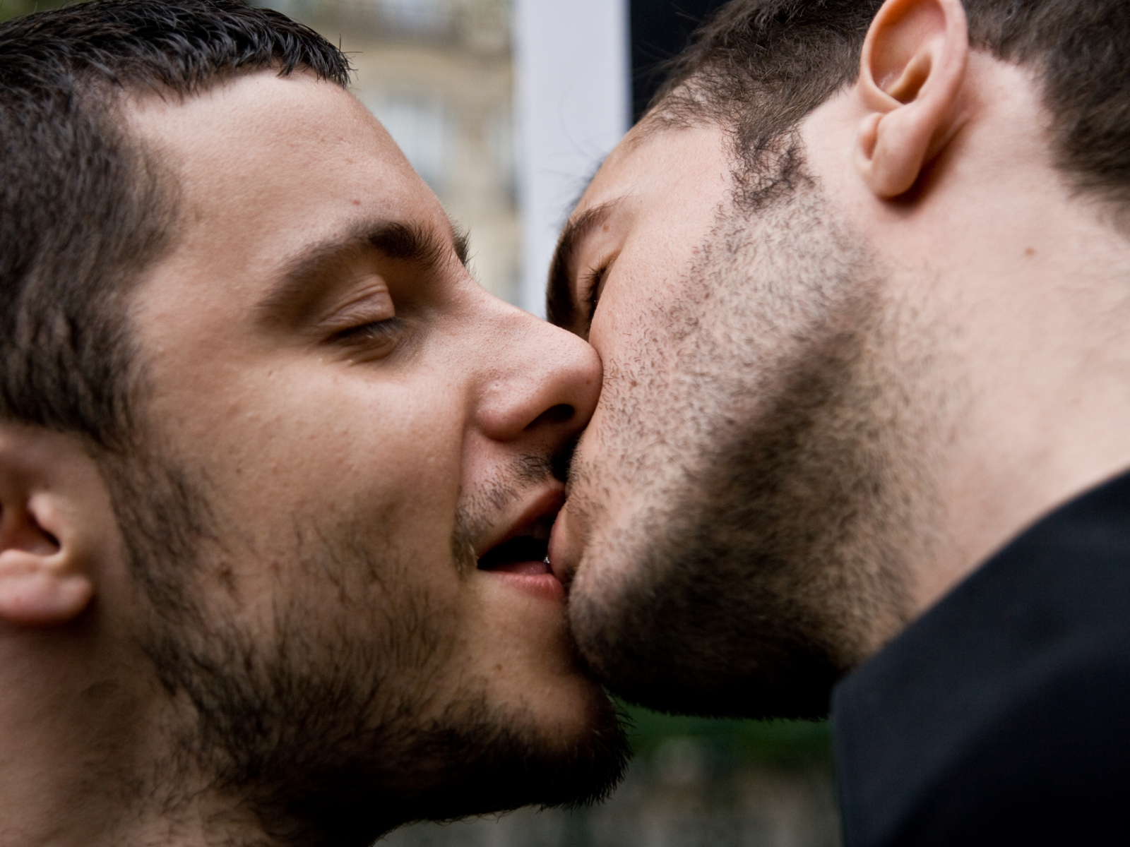
Paradigm FictionEro2
Assessment
PHASE 1
END PHASE 1
AI-Generated
Photograph
FEEDBACK
1-2 s
3 s
1-2 s
3 s
Variables
Arousal – How much did you feel sexually aroused ? 0 = Not at all; 6 = Very much
Enticement – How enticing would you rate this image to be? 0 = Not at all; 6 = Very much
Valence – The feeling evoked by this image was… 0 = Unpleasant; 6 = Pleasant
Fiction Feedback
Images Arousing
No image was particularly arousing
AI-Generated Images were more arousing
…
AI-Generation Algorithm
The difference between the photos and the AI-generated images was obvious
I felt like the labels were reversed (e.g., 'Photograph' for AI-generated images and vice versa)
…
Due to an implementation error, 60% of participants in the final sample received a different version of the feedback, which asked about the attractiveness of faces instead.
Notes:
Half-way phase1 there is a break and eye recalibration
Fiction Feedback (addition in comparison to fiction ero1 ; this feedback came from fakeface x ?)
Image Arousal
Please select all that apply
Some images were really arousing
No image was particularly arousing
AI-generated images were more arousing than the photos
AI-generated images were less arousing than the photos
Other (describe)
AI-Generation Algorithm
Please select all that apply
The difference between the photos and the AI-generated images was obvious
The difference between the photos and the AI-generated images was subtle
I didn't see any difference between photos and AI-generated images
I felt like the labels ('Photograph' and 'AI-Generated') were not always correct
I felt like the labels were reversed (e.g., 'Photograph' for AI-generated images and vice versa)
I feel like all the images were photos
I feel like all the images were AI-generated
Other (describe)

Slide 12
Paradigm FictionEro2
Assessment
PHASE 1
END PHASE 1
AI-Generated
Photograph
FEEDBACK
1-2 s
3 s
1-2 s
3 s
Variables
Arousal – How much did you feel sexually aroused ? 0 = Not at all; 6 = Very much
Enticement – How enticing would you rate this image to be? 0 = Not at all; 6 = Very much
Valence – The feeling evoked by this image was… 0 = Unpleasant; 6 = Pleasant
Fiction Feedback
Images Arousing
No image was particularly arousing
AI-Generated Images were more arousing
…
AI-Generation Algorithm
The difference between the photos and the AI-generated images was obvious
I felt like the labels were reversed (e.g., 'Photograph' for AI-generated images and vice versa)
…
Notes:
Half-way phase1 there is a break and eye recalibration
Fiction Feedback (addition in comparison to fiction ero1 ; this feedback came from fakeface x ?)
Image Arousal
Please select all that apply
Some images were really arousing
No image was particularly arousing
AI-generated images were more arousing than the photos
AI-generated images were less arousing than the photos
Other (describe)
AI-Generation Algorithm
Please select all that apply
The difference between the photos and the AI-generated images was obvious
The difference between the photos and the AI-generated images was subtle
I didn't see any difference between photos and AI-generated images
I felt like the labels ('Photograph' and 'AI-Generated') were not always correct
I felt like the labels were reversed (e.g., 'Photograph' for AI-generated images and vice versa)
I feel like all the images were photos
I feel like all the images were AI-generated
Other (describe)
Changed from analahoues to

Slide 13
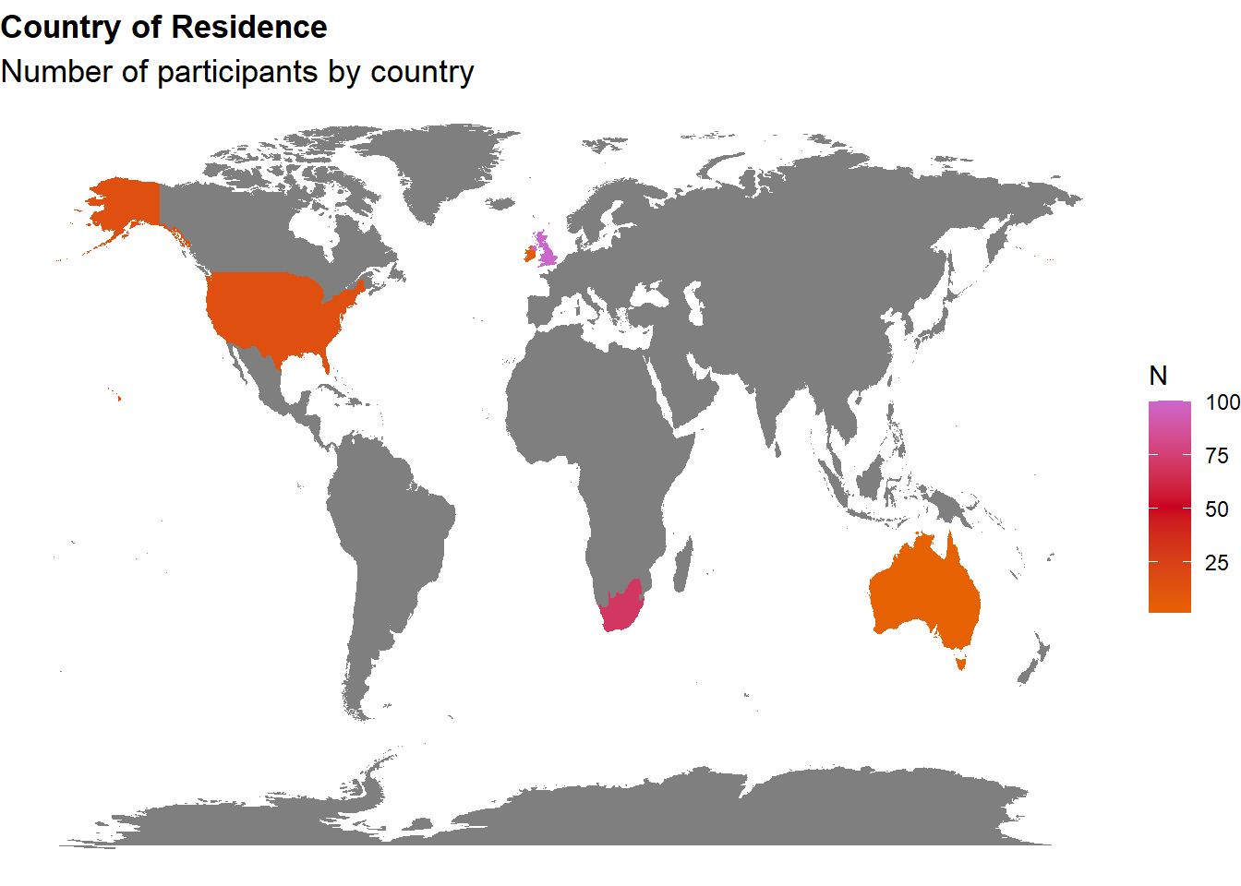
Demographics FictionEro2
The initial sample consisted of 211 participants (Mean age = 36.1, SD = 12.9), 48.8% women, 49.3% men, 1.90% non-binary, range from 18-80.
Exclusions
5 participants that used a mobile device
3 participants showed no variation in their arousal response (i.e., did not move the scales).
1 participant had a negative correlation between arousal and enticement AND had a negative correlation between arousal and valance.
Only 4 participants self-reported as neither female nor male, hence they were excluded from further analysis.
1 participant whose stimuli was not relevant for its gender and sexual orientation.
The final sample includes 197 participants (Mean age = 36.5, SD = 13.1), 48.2% women, 51.8% men, range from 18-80.
Notes:
There were only 19 bisexuals, and 8 homosexuals compared to 170 heterosexuals

Slide 14
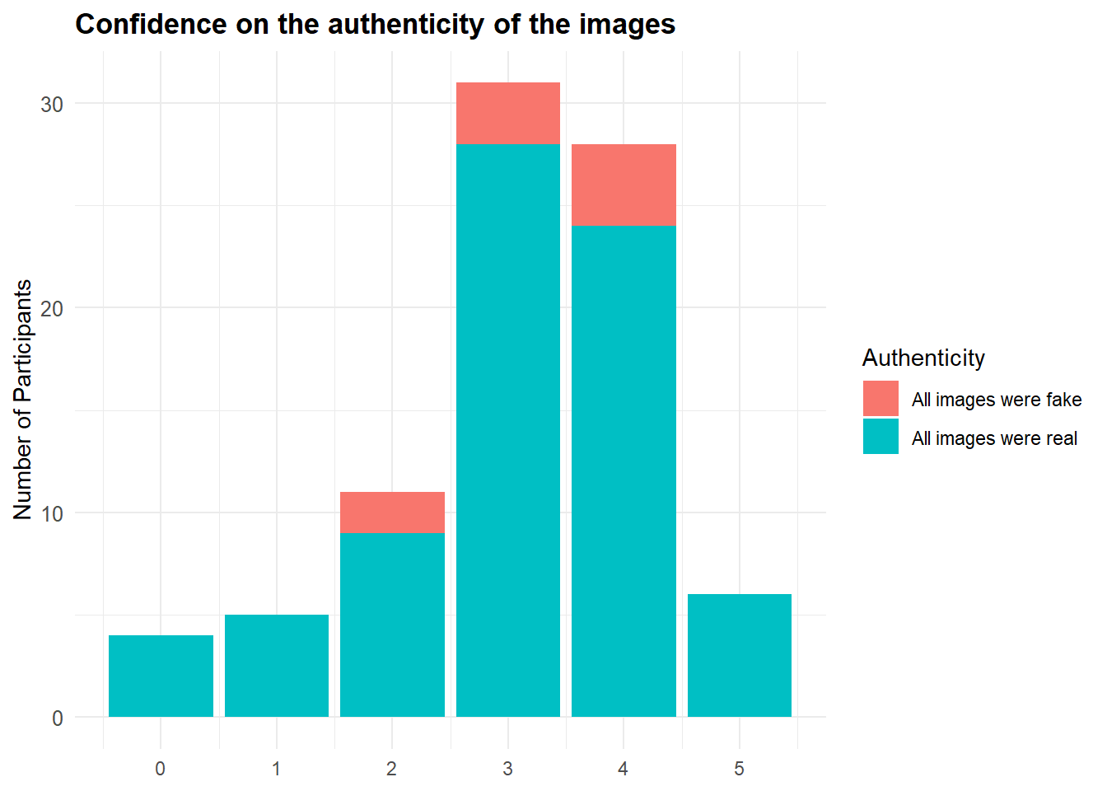
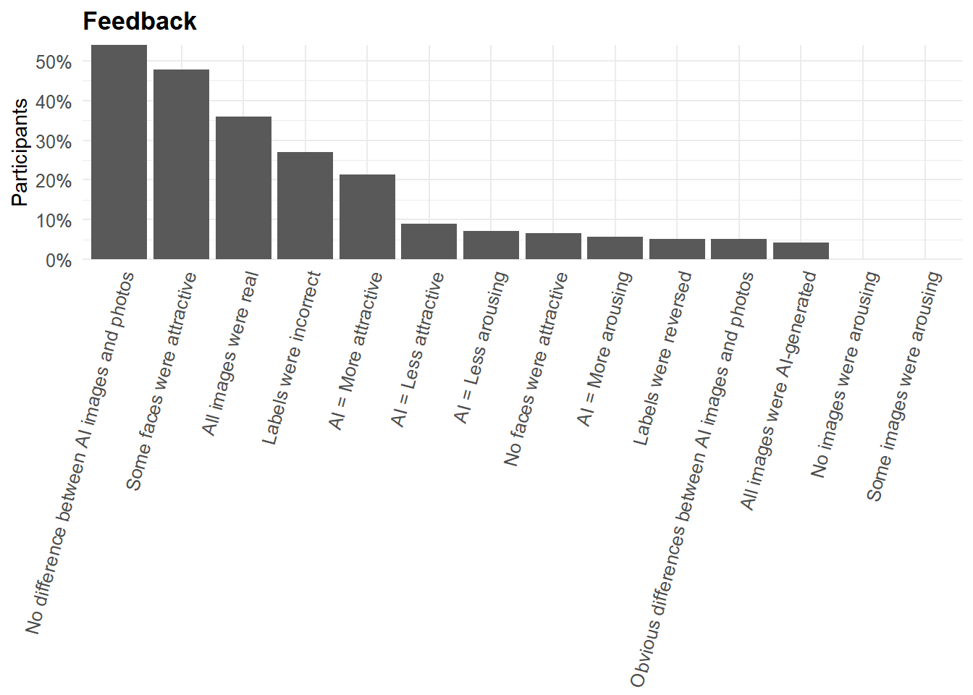
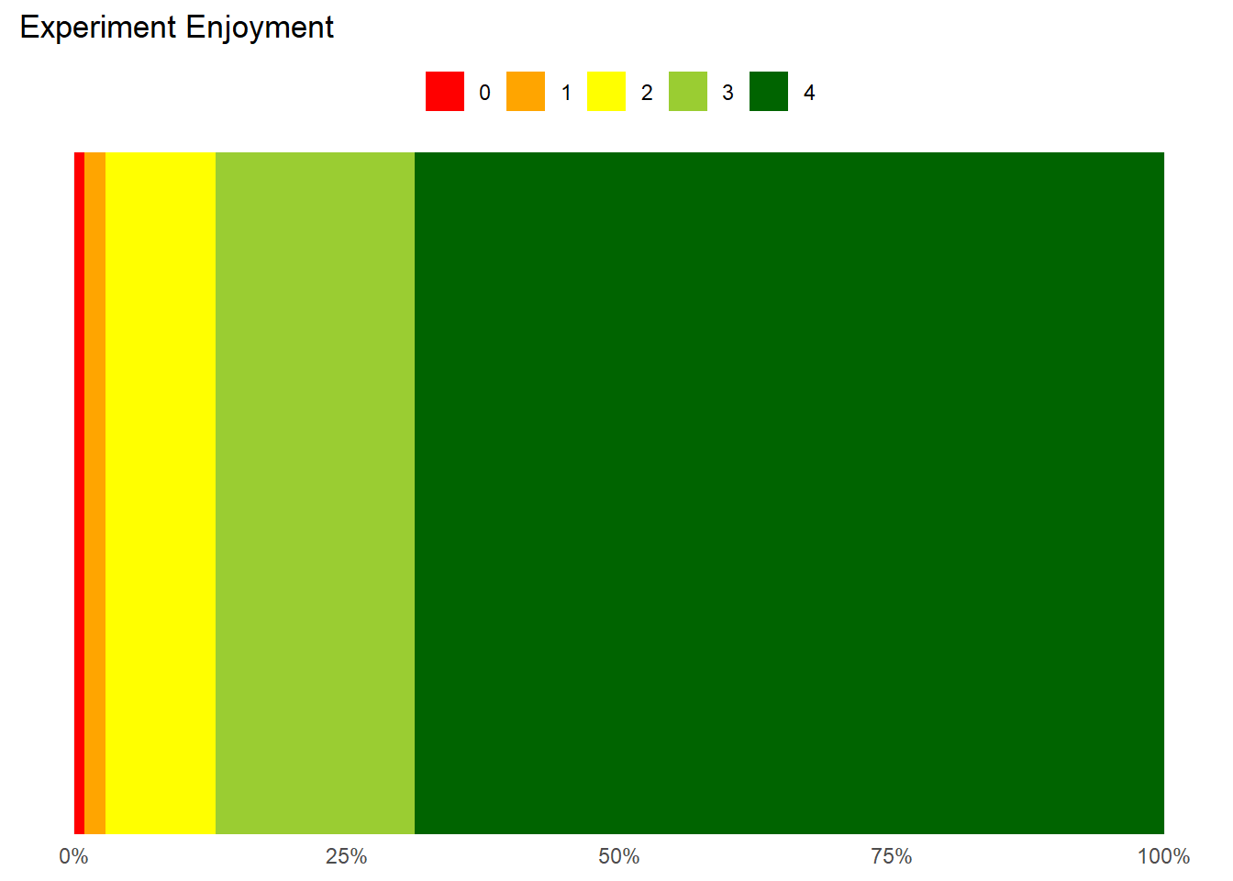

Feedback FictionEro2
NOTE 115 participants had a misphrased version of the feedback (corrected for the last 82). No evidence for it to me a major issue
Notes:
Cleaning script: https://realitybending.github.io/FictionEro/study2/analysis/1_cleaning.html
NOTE that due to a mistake in the study’s implementation, some of the feedback was incorrect, e.g., “Some faces were attractive” and “AI-generated faces were less attractive” rather than “Some images were arousing” and “AI-generated images were less arousing”.

Slide 15
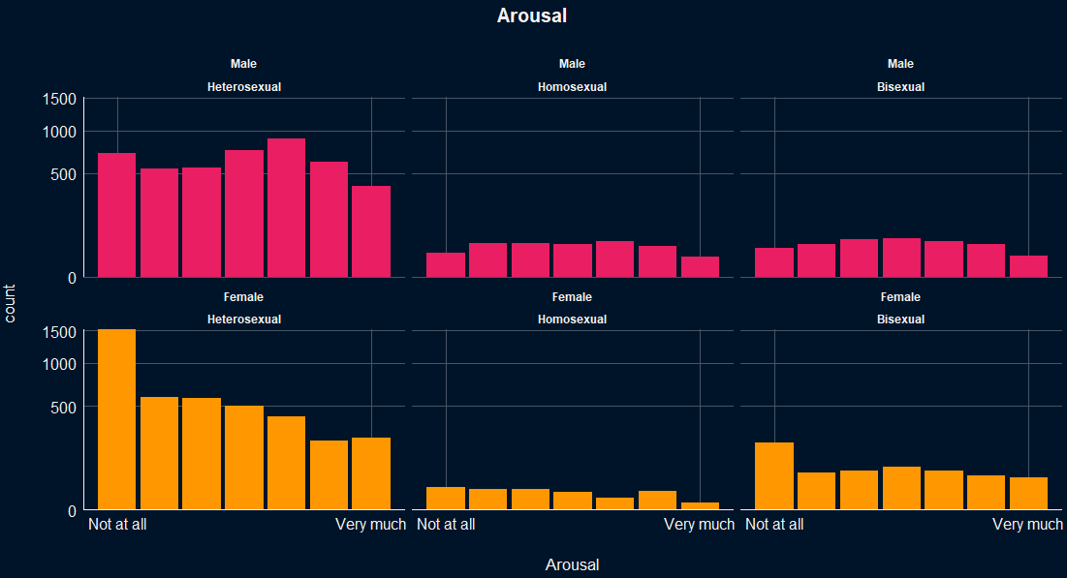
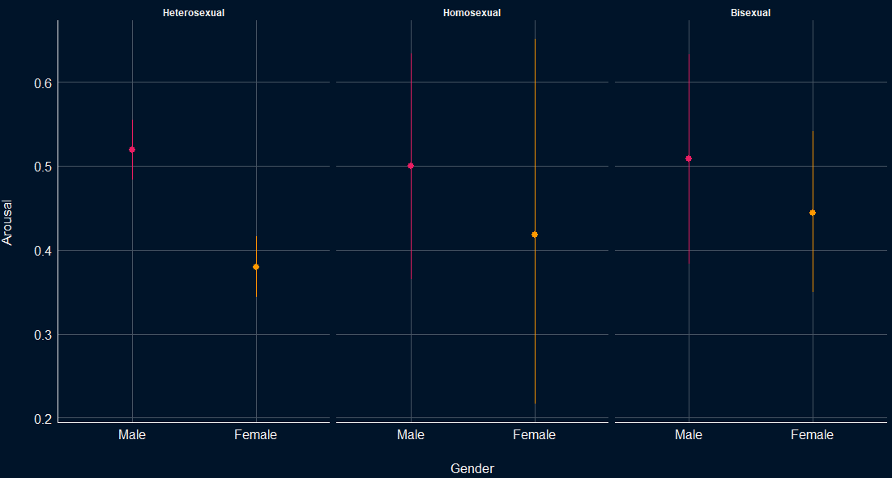
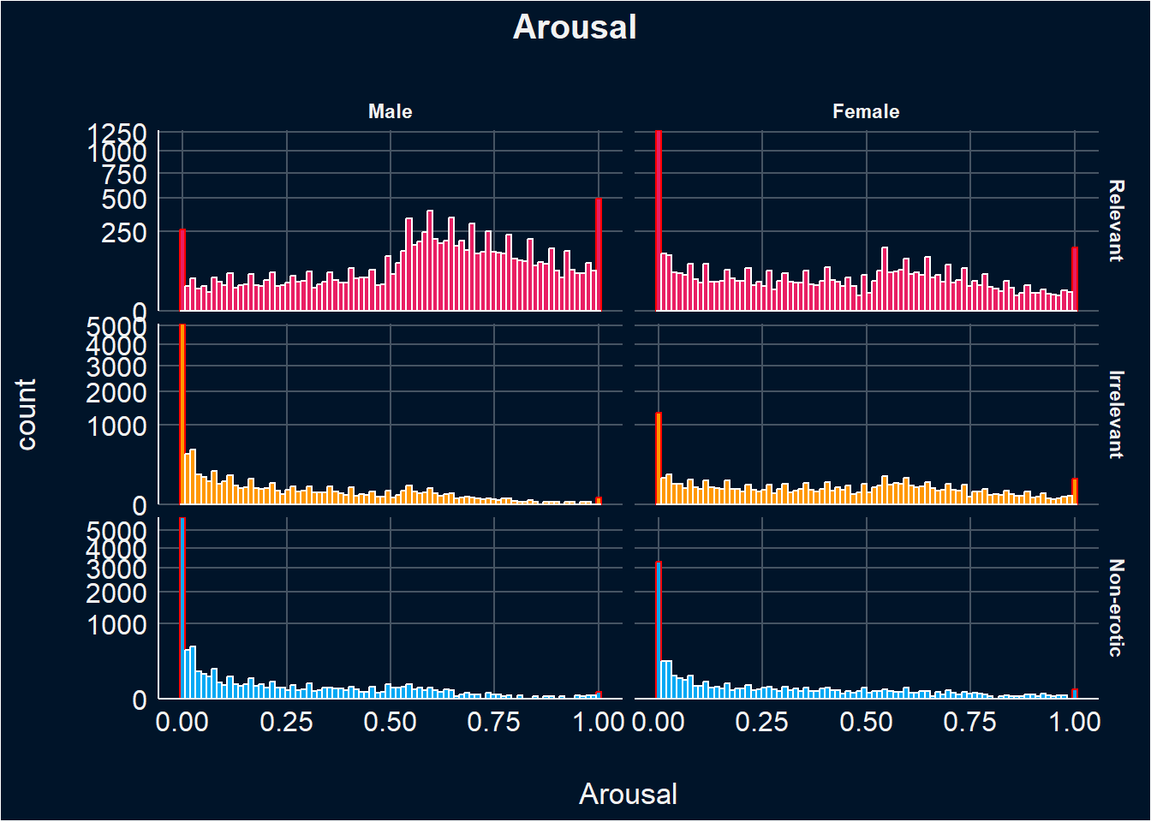
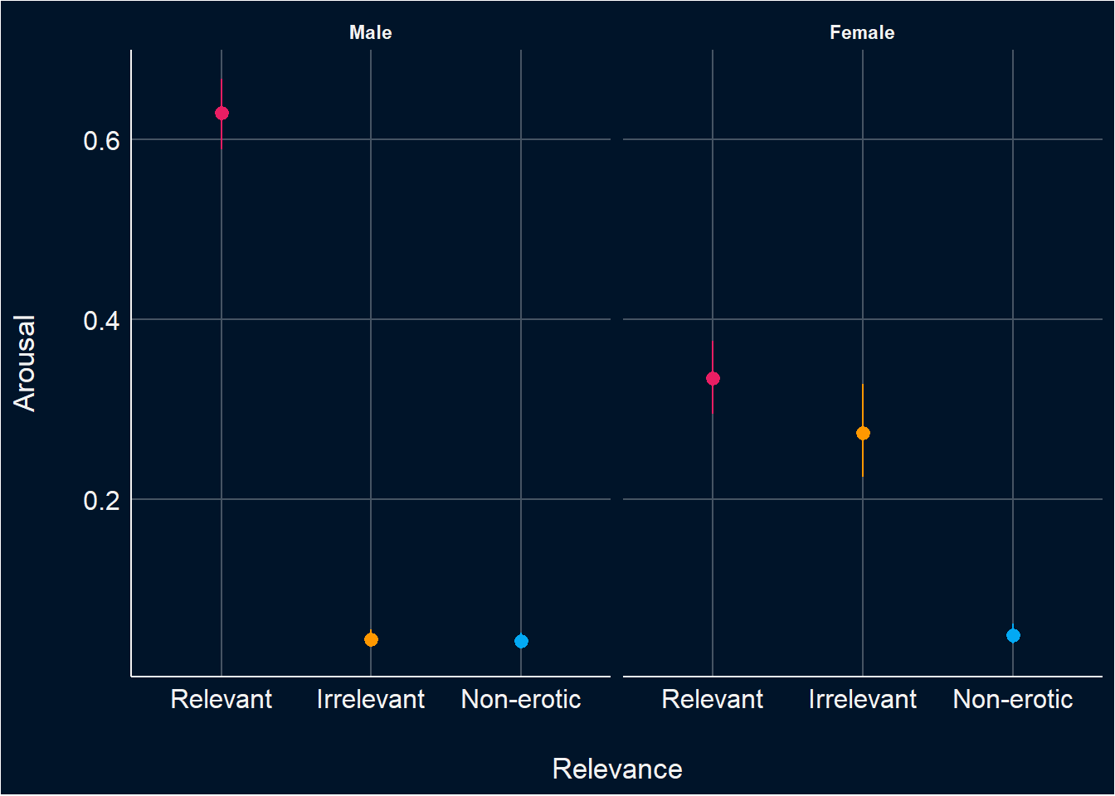
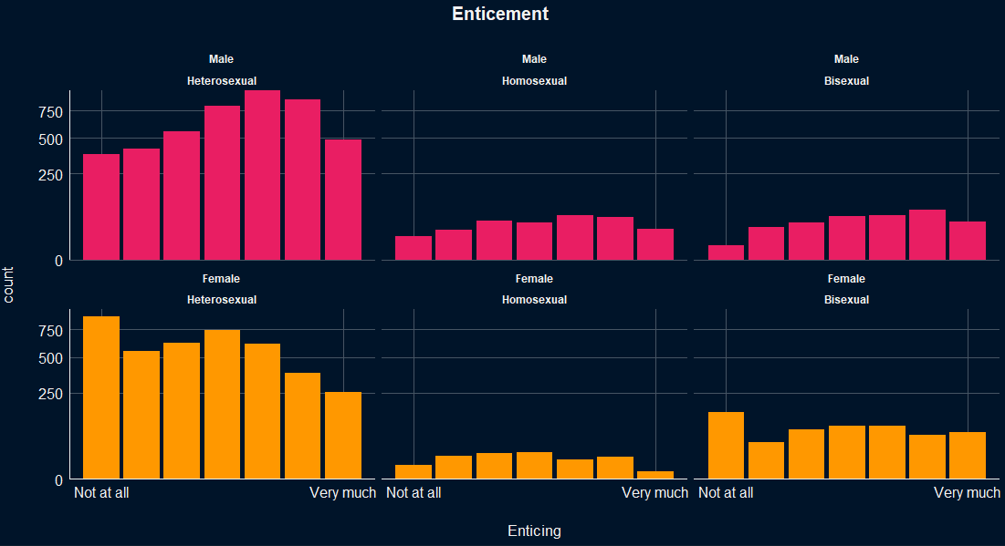
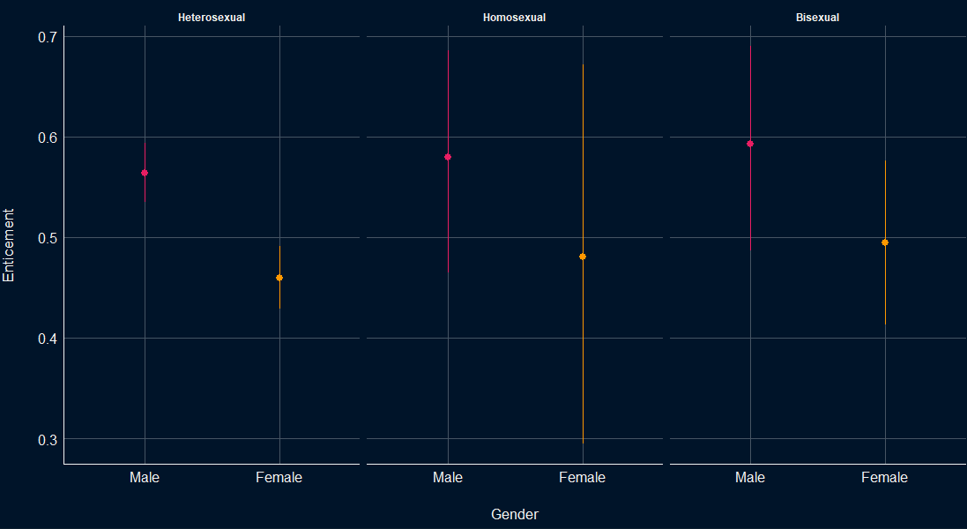
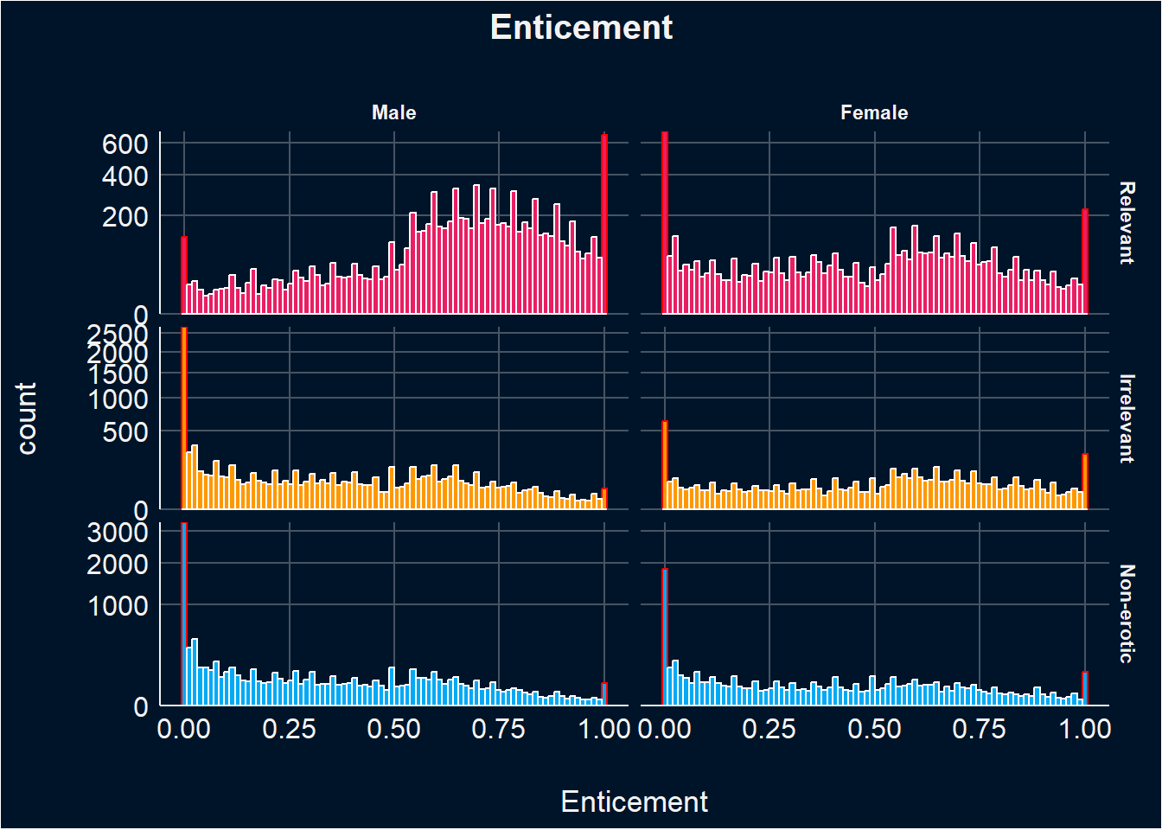
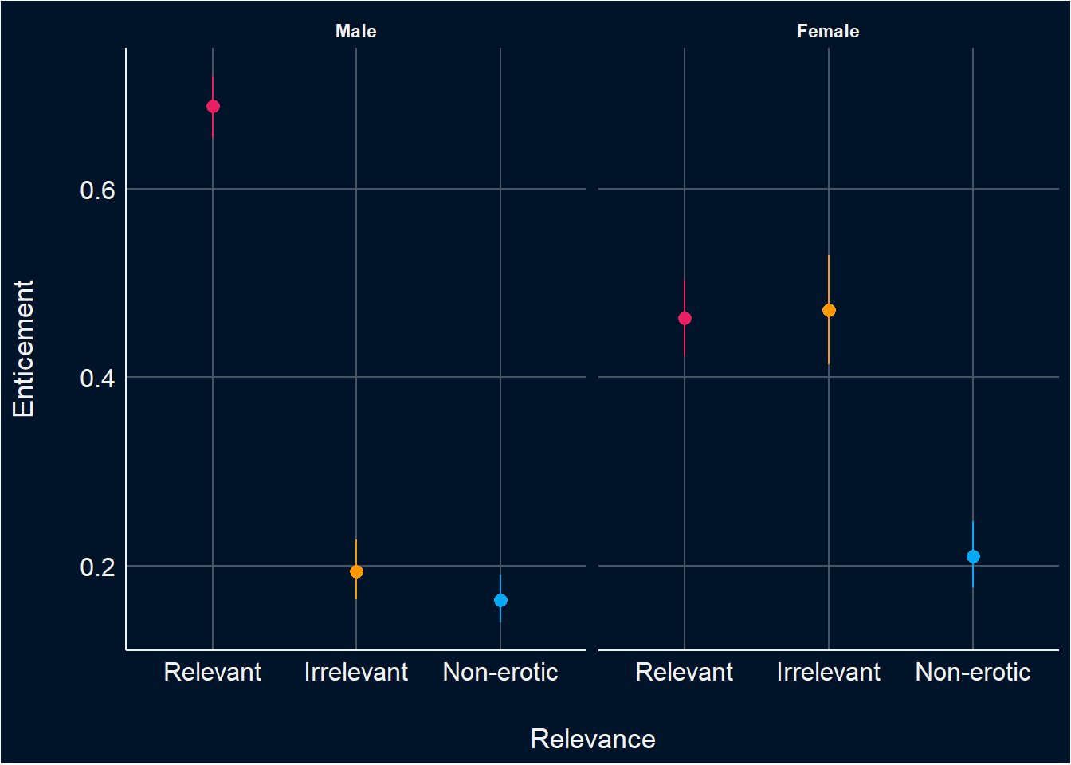
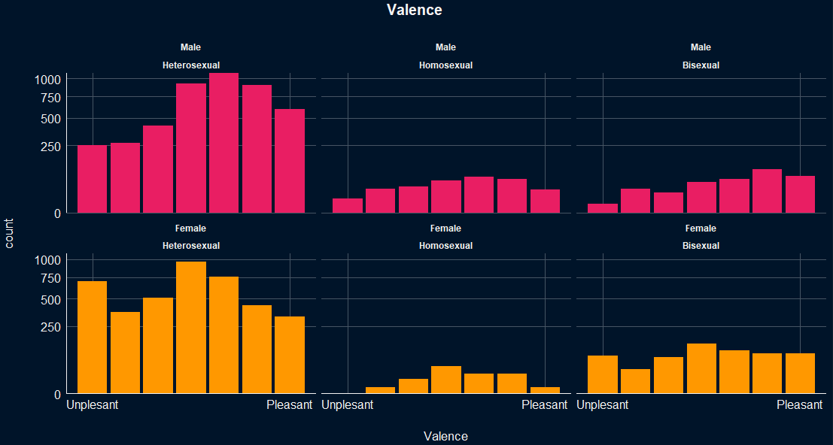
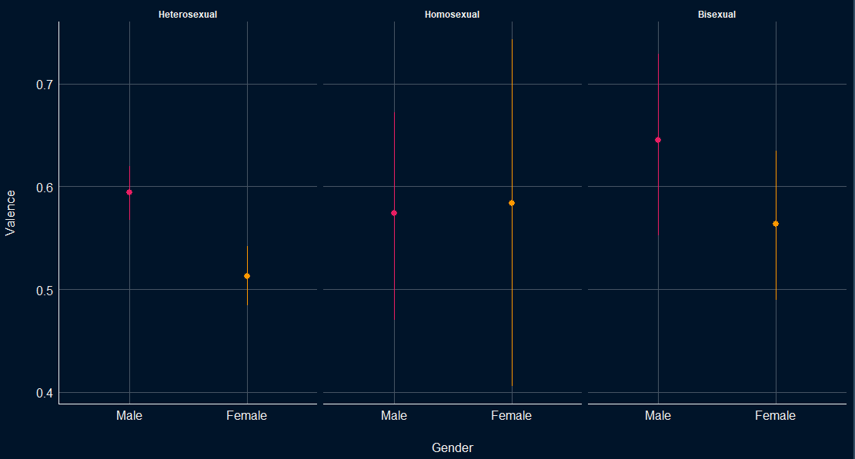
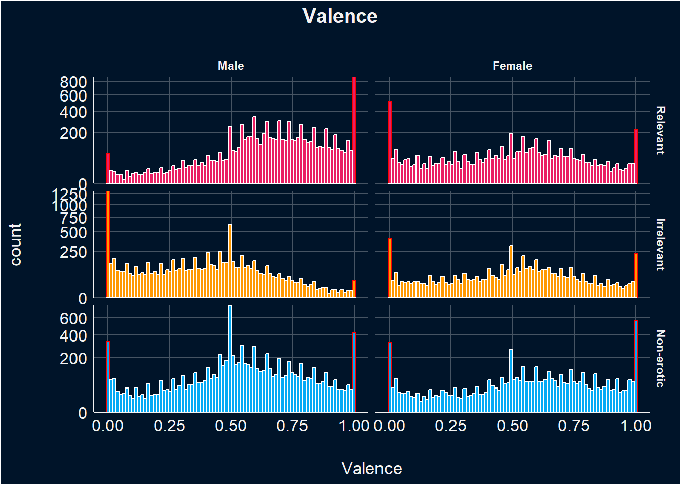
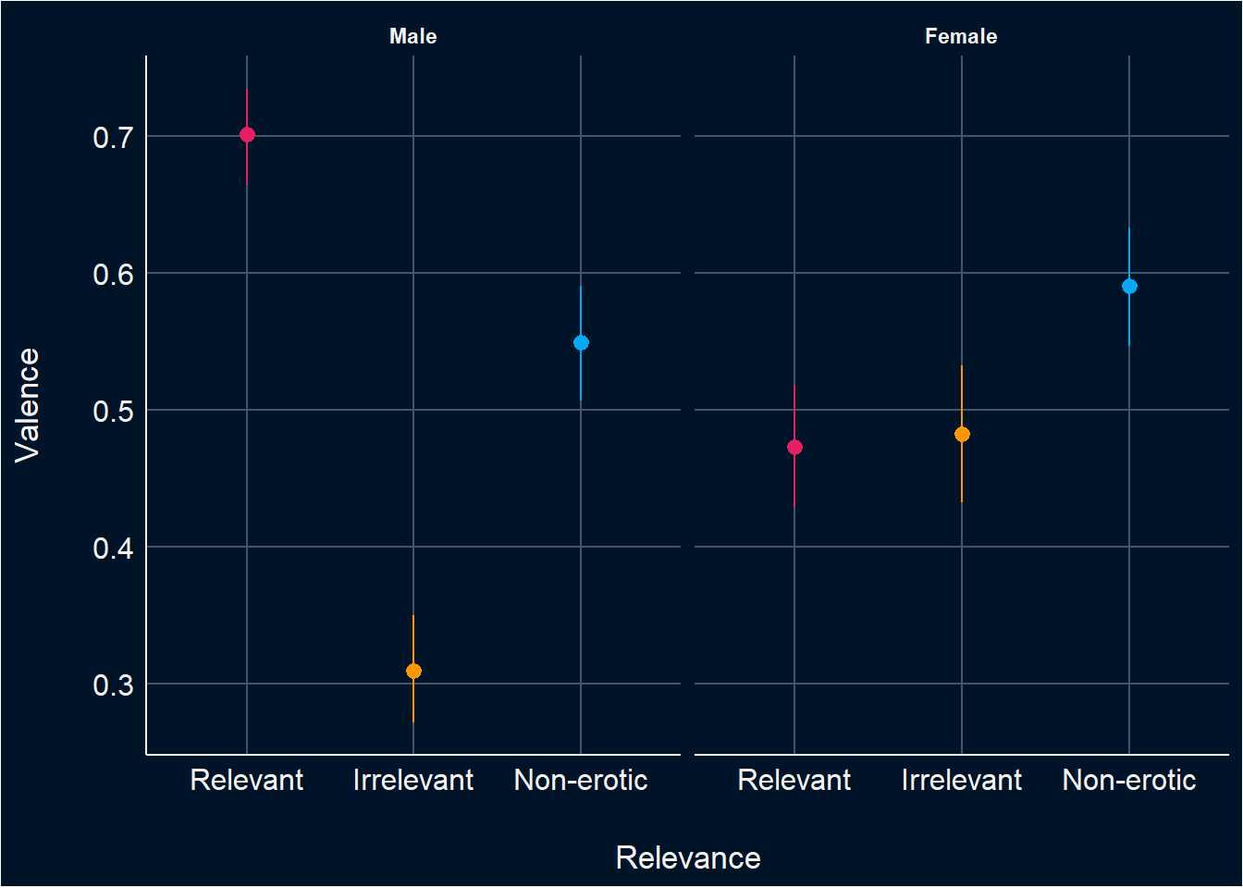
Affective Results FictionEro2
The Arousal, Enticement and Valence data were assessed using Likert scales, hence lending itself to ordered beta model (Kubinec, 2022).
These models evaluates the effects of Gender, and Sexual Orientation on Subjective Ratings, accounting for random variability due to participants and items (i.e., random intercepts).
Main results on Subjective Ratings
On average women rate images significantly lower in arousal, enticement, and valence compared to men.
Sexual Orientation did not significantly influence Arousal, Enticement and Valence ratings
Given the small number of participants self-describing as bisexual (N=19) and homosexual (N=8), the following analysis will focus solely on heterosexual individuals
Notes:
Analysis script: https://realitybending.github.io/FictionEro/study2/analysis/2_emotion.html
Graphs on the right are from fictionero1

Slide 16
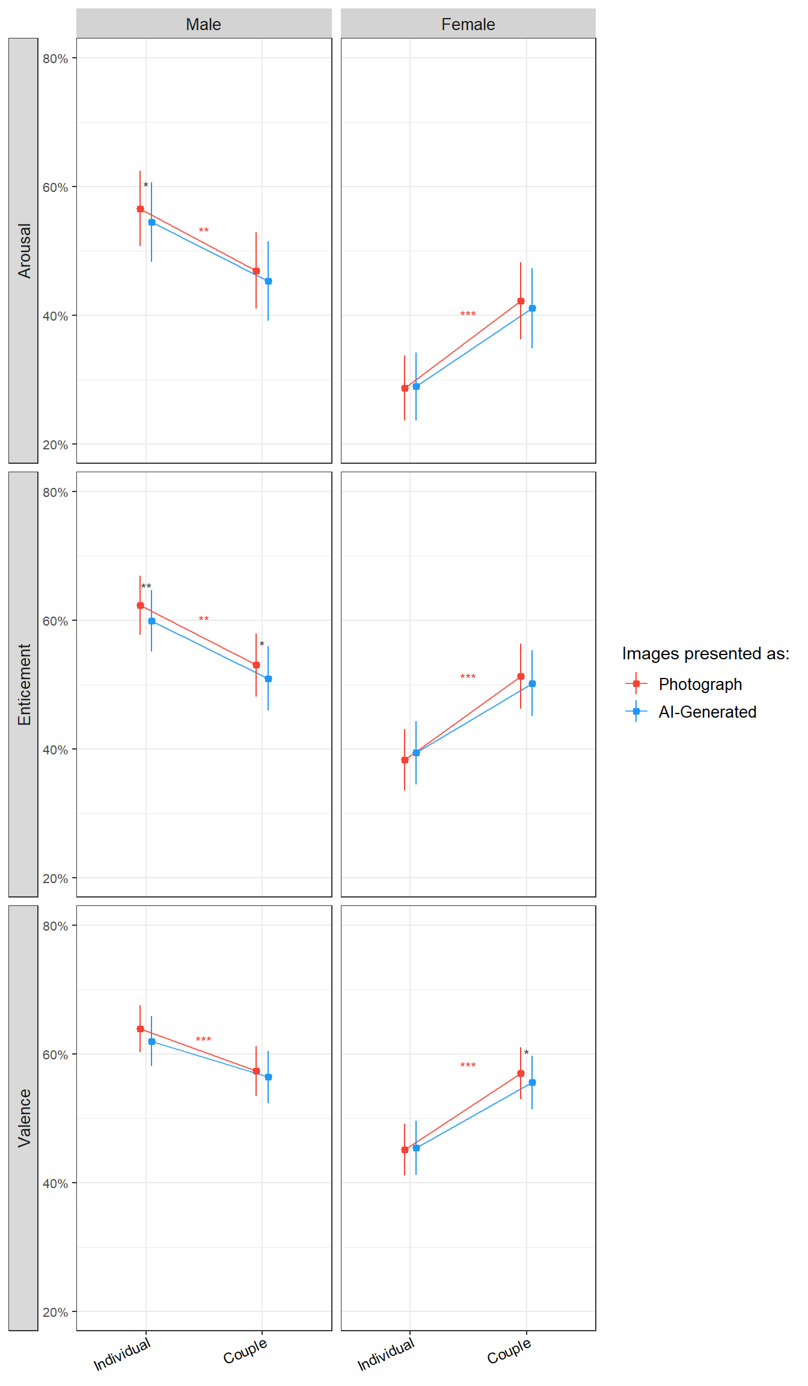
Affective Impact of Fiction FictionEro2
Main effect of Gender
Women gave significant lower ratings than men for individual images on arousal, enticement, and valence.
Interaction between Gender and Stimuli Type
Men rated couple images lower than individual ones in arousal and enticement.
Women rated couple images higher than individual ones in arousal, enticement, and valence.
Effect of Condition (AI vs Photograph)
Men rated AI-generated images of individuals consistently lower than photographic images of individuals across all affective dimensions.
Men also rated AI-generated images of couples lower in enticement compared to photographic images of couples.
*
Notes:
Analysis script: https://realitybending.github.io/Fictio
nEro/study2/analysis/2_emotion.html
After adding stimuli type as a predictor of arousal, the main effect of gender on subjective ratings became significant

Slide 17
Affective Impact of Fiction FictionEro2
 | Arousal | Enticement | Valence | Emotionality*
Females | Women rated images of individuals lower in arousal than men (b= -1.17, p <.001). Women rated images of couples higher in arousal than images of individuals (b= 0.60, p <.001). | Women rated images of individuals lower in enticement than men (b=-0.98, p <.001). Women rated images of couples higher in enticement than images of individuals (b= 0.53, p <.001). | Women rated images of individuals lower in valence than men (b= -0.77, p <.001). Women rated images of couples higher in valence than images of individuals (b= 0.48, p <.001). | Women rated images of individuals lower in emotionality than men (b= -1.11, p <.001). Women rated images of couples higher in emotionality than images of individuals (b= 0.62, p <.001).
Males | Men rated images of couples lower in arousal than images of individuals (b= - 0.39, p =.003). Men rated AI-generated images of individuals lower in arousal than photographic images of individuals (b = -0.08, p = .019). | Men rated images of couples lower in enticement than images of individuals (b= - 0.38, p = .004). Men rated AI-generated images lower in enticement than photographic images, for both images of individuals (b = -0.10, p = .005) and images of couples (b = -0.08, p < .022). | Men rated images of couples lower in valence than images of individuals (b= - 0.27, p < .001). Men rated AI-generated images of individuals lower in valence than photographic images of individuals (b = -0.08, p = .015). | Men rated images of couples lower in emotionality than images of individuals (b= - 0.11, p = .002). Men rated AI-generated images of individuals lower in emotionality than photographic ones (b = -0.11, p = .002).
Subjective Rating ~ Gender / Stimuli Type / Condition + (Condition| Participants) + (1| Stimulus)
Notes:
Note that this model only evaluates heterosexual individuals only
The difference in valence between AI-generated images and photographs of couples approached significance among males (b = -0.13, p = .051)
Note. Model evaluates effect of Gender, Stimuli Type and Condition on Subjective Ratings, accounting with participants and images as random intercepts, and condition as random slope for participants.
Intercept = Male, Photograph, photo of individuals.
*Emotionality : combined the data for arousal, valence and enticing into an emotionality factor.
Men rat images of couples lower in valence than images of individuals(b= - 0.30, p = .004).
Emotionality
We combined Arousal, Enticement, and Valence into a single summary score using a method called PCA, which finds the best way to capture what these ratings have in common. At first, the combined score went up when the original ratings went down, because of how the math worked. To make the result easier to understand, we flipped the direction — so now, higher Emotionality scores mean higher Arousal, Enticement, and Valence.

Slide 18
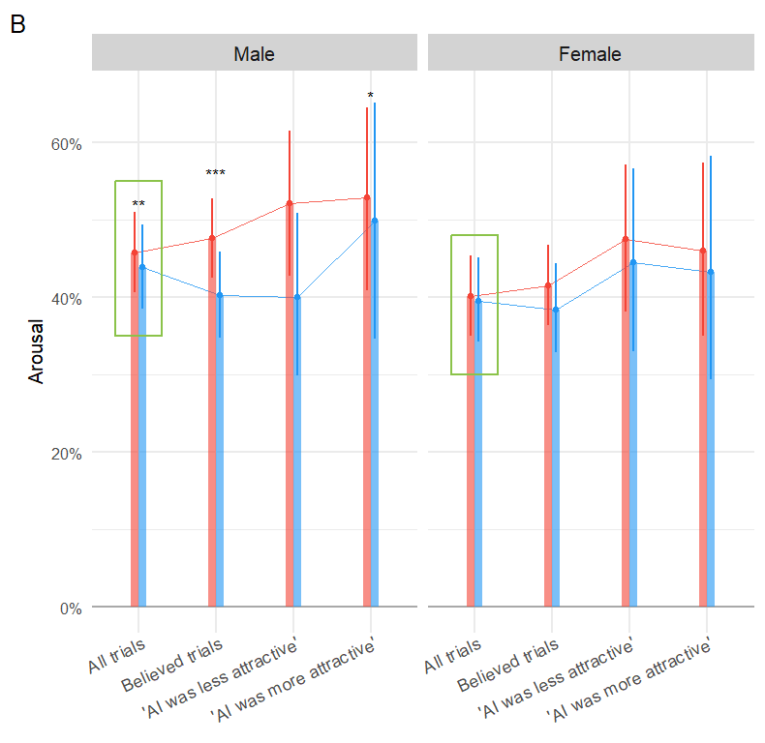
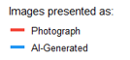
FictionEro2– Affective Results for Believed Trials
Affective Impact of Fiction - Believed Trials FictionEro2
Arousal scores were significantly lower for images labelled as AI-generated, only in male participants, both across all trials and specifically in trials where the label was believed
Similarly, Enticement and Valence ratings were significantly lower for AI-generated images among male participants in both all trials and believed trials
However, for trials believed to be real, the difference in arousal between AI-generated images and photographs approached significance among females (p = .057)
Interestingly, among female participants, Enticement and Valence scores were significantly lower for AI-generated images, but only in trials where the original label was believed to be accurate
Notes:
Analysis script: https://realitybending.github.io/FictionEro/study2/analysis/2_emotion.html
Arousal rating differences between photograph and AI-G for believed trials for women almost reached significance

Slide 19
Affective Impact of Fiction - Believed Trial FictionEro2
 | Arousal | Enticement | Valence | Emotionality*
Females | Females, who agreed with the original label, rated images lower in arousal then men (b = 0.25, p = 0.041). | Females rated AI-generated images lower in enticement than images labelled as photos, for believed trials (b= -0.09, p = .036). | Females rated AI-generated images lower in valence than images labelled as photos, for believed trials (b= -0.17, p < .001). | Females rated AI-generated images lower in emotionality than images labelled as photos, for trials where they agreed with the original labels (b= -0.14, p < .001).
Males | Men rated AI-generated images significantly lower in arousal than photographic images, for believed trials (b = -0.29, p < .001). | Men rated AI-generated images significantly lower in enticement than photographic images, for believed trials (b = -0.31, p < .001). | Men rated AI-generated images lower in Valence than photographic ones in valence, for trials where they agreed with the original labels (b = -0.24, p < .001). | Men rated AI-generated images lower in Emotionality than photographic ones, for believed trials (b = -0.33, p < .001)
Subjective Rating ~ Gender / Condition + (Condition| Participants) + (Condition| Stimulus),
data = filter(df, Condition Believed == “True”
Notes:
Note that this model only evaluates heterosexual individuals only
Note. Model evaluates effect of Gender and Condition on Subjective Ratings, accounting with participants and images as random intercepts. *Emotionality : combined the data for arousal, valence and enticing into an emotionality factor.
Effect of condition on believed trials almost reached significant for women for arousal scores (b = -0.09, p = .057)

Slide 20
Moderators - Questionnaires FictionEro2
 | Arousal | Enticement | Valence | FICTION ERO 1
Attitudes Towards AI | Females who reported having higher positive attitudes towards AI rated AI-generated images as more arousing (b = 0.07, p = 0.007). | Females who reported having higher positive attitudes towards AI rated AI-generated images as more enticing (b = 0.05, p = 0.05). Males who reported having higher negative attitudes towards AI rated AI-generated images as less enticing (b = -0.04, p = .017). | Females who have more negative attitudes towards AI rated AI-generated images lower in valence compared to images labelled as photographs (b = -0.04, p = 0.025). Males who have more negative attitudes towards AI rated AI-generated images lower in valence compared to images labelled as photographs (b = -0.03, p = 0.022). | Positive or negative attitudes towards AI was ONLY a significant moderator for valence scores for females
Knowledge About AI | NS | NS | Males who reported having higher knowledge about AI tended to rate AI-Generated images higher in valence (b = 0.04, p = 0.012). | AI-knowledge was not a significant moderator for any ratings or genders
Frequency of Porn Consumption | NS | NS | NS | Frequency of Porn Consumption was a moderator for females' ratings of arousal
Sexual Activity | NS | Females who reported having had sexual activity within the 3 previous days tended to rate AI images higher in enticement (b = 0.51, p = 0.013). | NS | Arousal scores for females were moderated by levels of sexual activity
Notes:
Analysis script: https://realitybending.github.io/FictionEro/study2/analysis/2_emotion.html
Note that the model evaluates whether the relationship between Gender and Condition on Arousal , Enticement and Valence is moderated by AI-attitudes, porn frequency and usage, sexual activity, and feedback.
Calculations:
BAIT_Videos was calculated by averaging participants’ agreement with the statement that current AI algorithms can generate very realistic videos and the inverse of their agreement with the statement that videos generated by AI have obvious problems that make them easy to spot as fake. Higher scores reflect stronger beliefs in the visual realism and technical reliability of AI-generated videos.
BAIT_Visual was computed as the average of four items: belief that AI algorithms can generate very realistic images, the inverse of belief that AI-generated images always contain errors and artifacts, agreement that CGI can perfectly imitate reality, and belief that technology allows the creation of environments that seem just as real as reality. Higher scores capture stronger beliefs in the visual realism and immersive quality of AI-generated and computer-generated content.
BAIT_Text was calculated by averaging agreement with the belief that AI assistants can write texts indistinguishable from those written by humans and the inverse of the belief that AI-written documents usually read differently than human-written ones.
Higher scores indicate stronger beliefs in the linguistic realism of AI-generated text.
BAIT_Negative was computed by averaging levels of agreement with the statements “AI is dangerous” and “I am worried about future uses of AI”. This composite reflects participants’ negative attitudes toward AI.
BAIT_Positive was calculated by averaging agreement with the statements “AI is exciting” and “Much of society will benefit from a future full of AI”. This score represents positive attitudes towards AI.

Slide 21
Moderators – Feedback FictionEro2
 | Arousal | Enticement | Valence | FICTION ERO 1
Feedback | Females who reported not finding any faces attractive tended to rate AI-Generated images lower in arousal (b = -0.31, p = 0.029). Males who reported that AI-Generated images were more attractive rated these images higher in arousal compared to images labelled as photographs (b = 0.14 , p = .034). | NS | Males who reported finding AI-Generated images more attractive rated these images higher in valence (b = 0.13, p = 0.033). | Finding AI-Generated images more arousing moderated arousal and enticement ratings for females Finding AI-generated images as less arousing moderated arousal ratings for men Reporting not being able to discriminate between AI and photos moderated valence ratings for men
NOTE Participants’ feedback largely reflected their expectations and aligned with their general experiences.
Notes:
Analysis script: https://realitybending.github.io/FictionEro/study2/analysis/2_emotion.html
Note that the model evaluates whether the relationship between Gender and Condition on Arousal , Enticement and Valence is moderated by AI-attitudes, porn frequency and usage, sexual activity, and feedback.
Calculations:
BAIT_Videos was calculated by averaging participants’ agreement with the statement that current AI algorithms can generate very realistic videos and the inverse of their agreement with the statement that videos generated by AI have obvious problems that make them easy to spot as fake. Higher scores reflect stronger beliefs in the visual realism and technical reliability of AI-generated videos.
BAIT_Visual was computed as the average of four items: belief that AI algorithms can generate very realistic images, the inverse of belief that AI-generated images always contain errors and artifacts, agreement that CGI can perfectly imitate reality, and belief that technology allows the creation of environments that seem just as real as reality. Higher scores capture stronger beliefs in the visual realism and immersive quality of AI-generated and computer-generated content.
BAIT_Text was calculated by averaging agreement with the belief that AI assistants can write texts indistinguishable from those written by humans and the inverse of the belief that AI-written documents usually read differently than human-written ones.
Higher scores indicate stronger beliefs in the linguistic realism of AI-generated text.
BAIT_Negative was computed by averaging levels of agreement with the statements “AI is dangerous” and “I am worried about future uses of AI”. This composite reflects participants’ negative attitudes toward AI.
BAIT_Positive was calculated by averaging agreement with the statements “AI is exciting” and “Much of society will benefit from a future full of AI”. This score represents positive attitudes towards AI.

Slide 22
Affective Impact of Fiction - Believed Trial FictionEro1
 | Arousal | Enticement | Valence | Emotionality
Attitudes Towards AI | NS | NS | Females who have more positive attitudes towards AI rated AI-generated images higher in valence compared to images labelled as photographs. (b = .36, p < .001) | Females who have a more positive attitudes towards AI rated AI-Generated images higher in emotionality compared to images labelled as photographs. (b = .30, p < .05)
Knowledge About AI | NS | NS | NS | NS
Porn Usage | Females with higher levels of porn usage rated AI-generated images lower in arousal compared to photographs. (b = -.08, p < .05) | NS | NS | NS
Frequency of Porn Consumption | NS | NS | NS | NS
Sexual Activity | The effect of AI-Generated condition on arousal ratings varies with different levels of sexual activity for females. (b = -.06, p < .05) | NA | NA | NA
Feedback | Females who reported that AI-Generated images were more arousing rated these images higher in arousal compared to images labelled as photographs. (b =.15, p < .05) Males who reported that AI-Generated images as less arousing rated these images lower in arousal compared to images labelled as photographs. (b = -.14 , p < .05) | Females who reported that AI-Generated images were more arousing rated these images higher in enticement compared to images labelled as photographs. (b =.15, p < .05). | Males who reported that they could not discriminate between AI-Generated and photograph images, rated AI-Generated images higher in valence compared to images labelled as photographs. (b = .11, p <.01) | Females who reported that AI-Generated images were more arousing rated these images higher in emotionality compared to images labelled as photographs. (b =.14, p < .05). Males who reported that AI-Generated images as less arousing rated these images lower in emotionality compared to images labelled as photographs. (b = -.16 , p < .051)
Note. Model evaluates whether the relationship between sex, condition and relevance and valence is moderated by AI-attitudes, porn frequency and usage, sexual activity, and feedback.*Emotionality : combined the data for arousal, valence and enticing into an emotionality factor.
Notes:
Analysis script: https://realitybending.github.io/FictionEro/study2/analysis/2_emotion.html

Slide 23
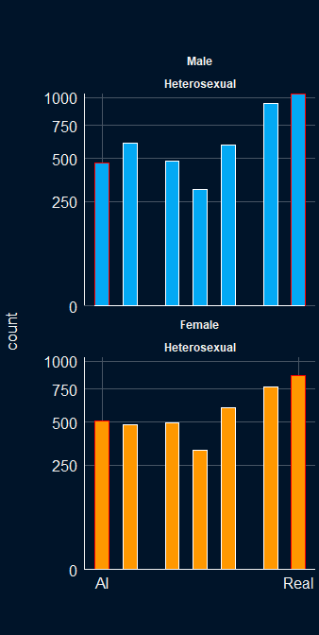
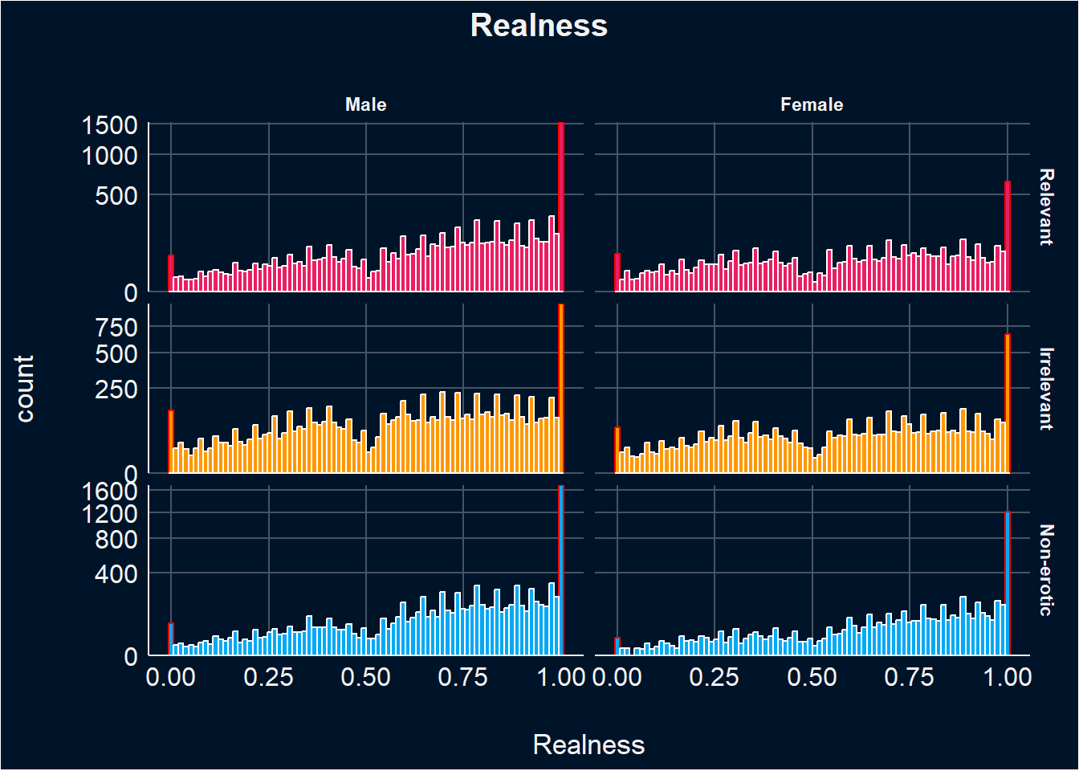
Determinants of Reality Beliefs FictionEro2
Like the subjective ratings data, the realness data contains a mixture of responses ranging from extreme values (-3 and 3). Hence, lending itself also to ordered beta model (Kubinec, 2022).
Neither Entropy, Complexity, Contrast, nor Luminance significantly influence the perceived realness of the images.
Note. Models look at the effect of Gender and Sexual Orientation on subjective ratings.
Notes:
Analysis script: https://realitybending.github.io/FictionEro/study2/analysis/3_realness.html
No physical characteristic influenced the perceived realness of the images
The distribution pattern is similar from fictionero1 (graphs on the right)

Slide 24
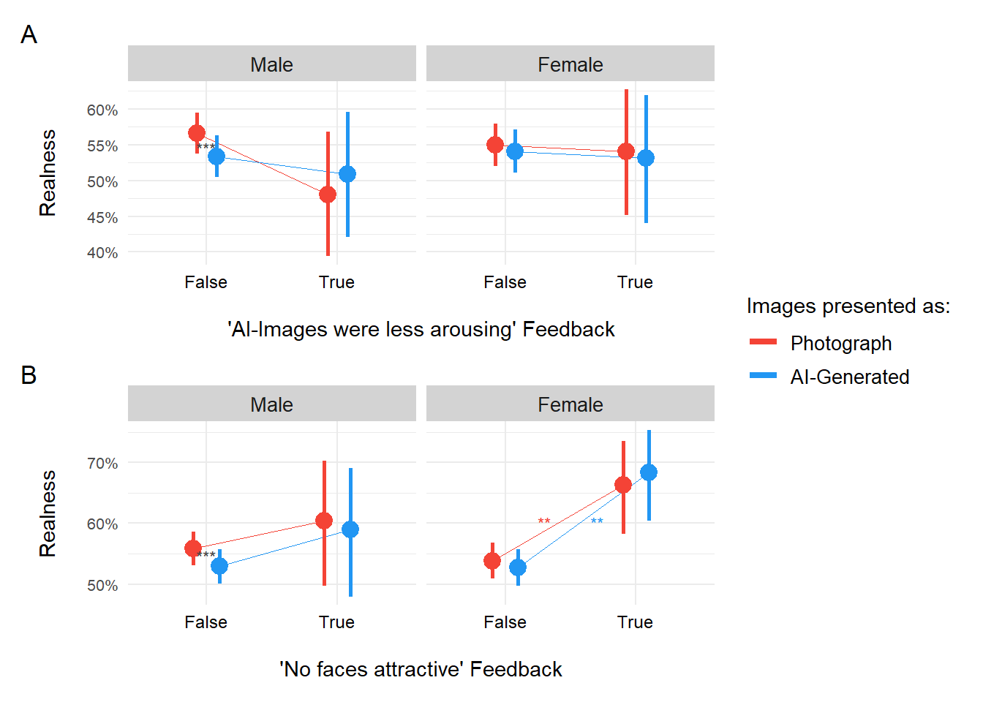
Determinants of Reality Beliefs FictionEro2
Moderators
Beliefs/Attitudes towards AI (i.e., visual, text, expertise on AI, positive and negative attitudes) was not a significant moderator for realness ratings
Porn Frequency and Sexual activity were not significant moderators for realness ratings
Feedback:
Females who reported finding no faces attractive rated images higher in realness (b=0.52, p = 0.004)
Females who reported the labels were incorrect rated images higher in realness (b = 0.22, p = 0.036)
Males who reported that all images were real images rated images higher in realness (b=0.28, p = 0.003)
Males who reported finding AI images less arousing rated these images higher in realness (b = 0.24, p = 0.035)
Only males rated AI-generated images as significantly less real than images labelled as photos (b = -0.11, p < .001)
Note. This model examines the influence of Gender and Condition on ratings of Realness, incorporating random effects for participants and items.
Notes:
Analysis script: https://realitybending.github.io/FictionEro/study2/analysis/3_realness.html
FictionEro 1 - Both males and females rated AI-generated images as significantly less real than photographs across all relevance categories.
Both genders rate images higher in realness as their beliefs in AI’s visual capabilities increases.
However, for females with strong beliefs in AI’s visual capabilities, the difference in realness ratings between photographs and AI-generated labelled images becomes minimal.
Porn usage moderated realness ratings, only for men presented with AI-generated non-erotic images.
Males who reported an inability to discriminate AI-generated images perceived both relevant and irrelevant AI-generated images as more real.
Females who reported an inability to discriminate AI-generated images showed increased realness ratings only for relevant AI-generated images.

Slide 25
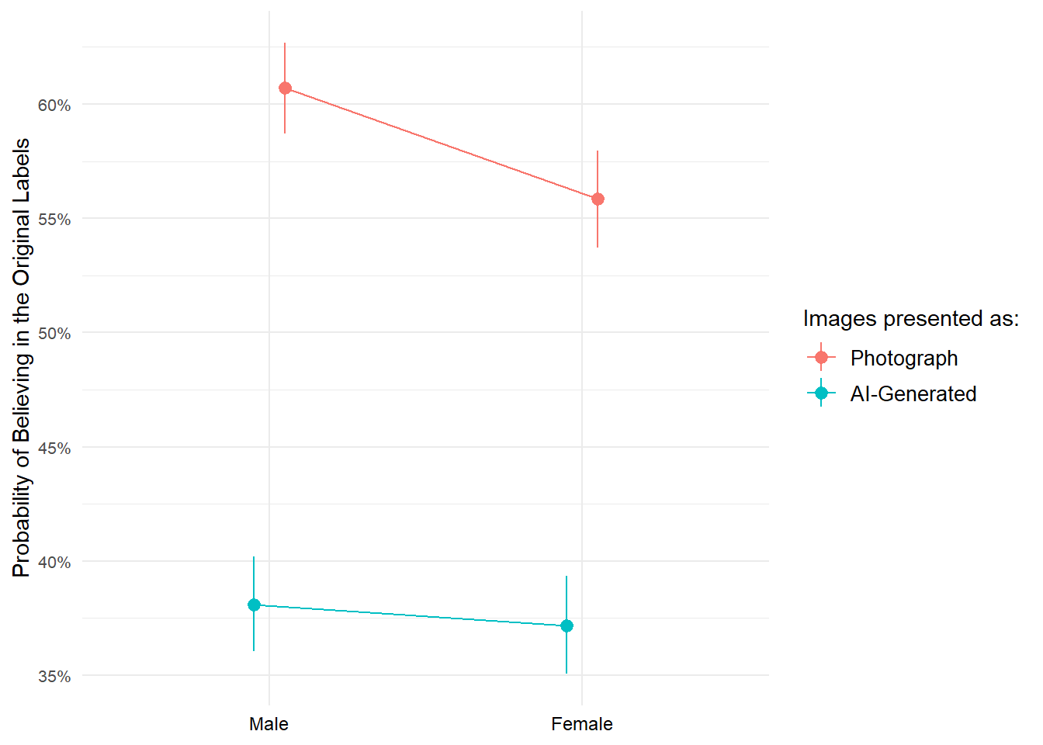
Determinants of Reality Beliefs FictionEro2
Probability of believing in the original label
When the image was labeled as real, females were 18% less likely than males to believe that label. This suggests that men tended to accept and carry on the "real" label more readily than women.
Participants were 60% less likely to believe the original label when the image was labelled as AI-generated, compared to when it was labeled as a photo. This means participants were much more likely to believe an image was real if it was labelled as such and showed skepticism toward AI-generated labels.
Note
However, the main effect of condition might be because people made more "real" judgments in general.
Note. This logistic regression model predicts the probability that a participant believed the condition (i.e., ratings on the nature of the stimuli matched that of the original labels), based on their gender, the condition they were shown (AI-generated vs. Photo), and their interaction.
Notes:
Analysis script: https://realitybending.github.io/FictionEro/study2/analysis/3_realness.html

Slide 26
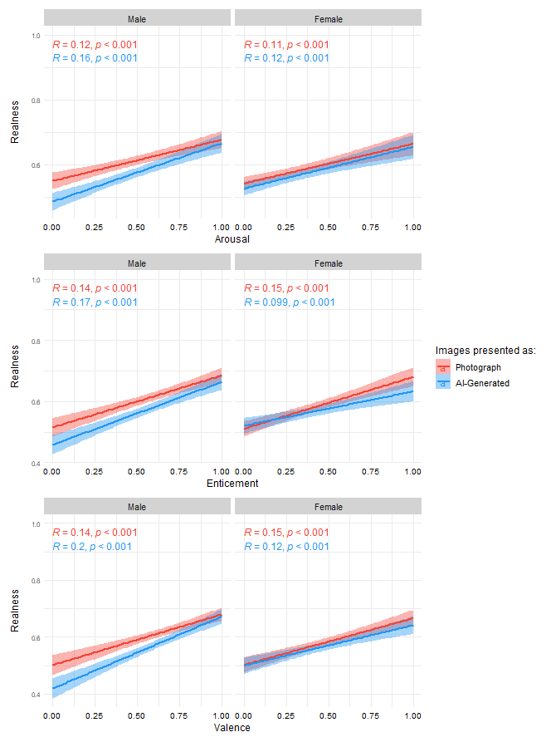
Determinants of Reality Beliefs FictionEro2
Are Subjective ratings correlated with Realness scores ?
All subjective ratings had, but small, positive correlations with Realness.
Is Realness predicted by Arousal?
Arousal significantly predicted realness (b = 0.65, p <.001)
The effect of arousal on realness scores was notably weaker for females (b = -0.29, p = .002) compared to males’ realness ratings.
For males, the effect of arousal on realness was reduced when judging AI-labelled images compared to those labelled as real photographs (b = -0.13, p = 0.18)
There was not a quadratic effect of arousal on realness scores
Notes:
Analysis script: https://realitybending.github.io/FictionEro/study2/analysis/3_realness.html
Porn Frequency – how many times do participants watch porn

Slide 27
Final Thoughts FictionEro2
Women rate images of individuals significantly lower in all subjective ratings compared to men.
The effect of condition (i.e., labelling images as AI-Generated and Photos) was only significant for males. Possible explanations:
Stimuli is not arousing enough for women → Change stimuli to negative? Or more erotic?
Social desirability might play a role in females' ratings of erotic stimuli → Add as a measure?
Floor effects
Task demand characteristics→ Could add instruction that “individuals rate AI-generated stimuli lower…”
- 2 conditions: with instruction and without instruction
Any other thoughts
Males prefer images of individuals and females prefer images of couples
Women also believe the labels to a lesser extent then men
Next steps
Physiological data - Different stimuli ?
More participants?
Start writing paper?

